Slide 1
Design Patterns
The Observer Pattern
IT 426

Slide 2
Definition
Gang of four:
“Define a one-to-many dependency between objects so that when one object changes state, all its dependents are notified and updated automatically”

Slide 3
A problem to consider
A simplified course management system
Tracking students, teachers and assignments
Canvas
Student
Teacher
Assignment

Slide 4
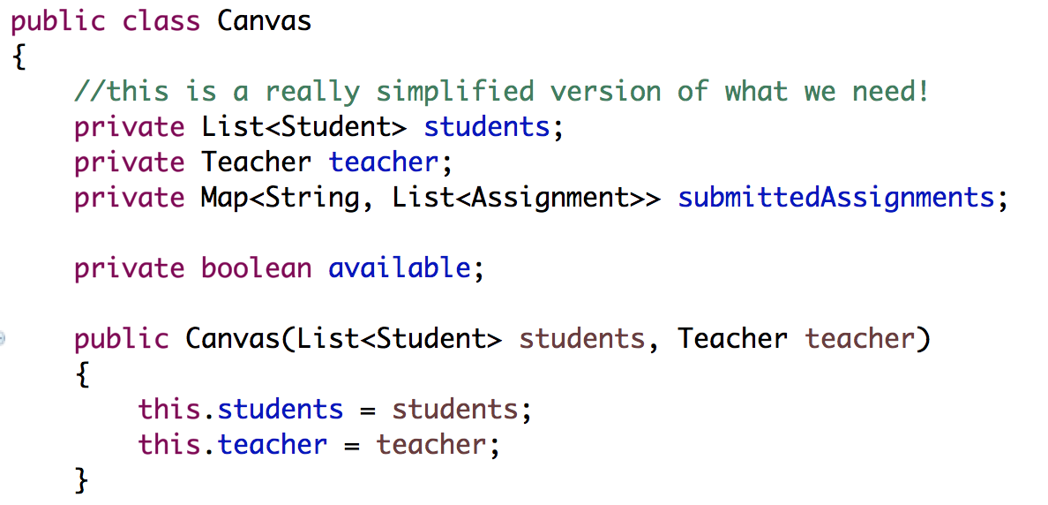
Canvas
Canvas depends on Student, Teacher and Assignment

Slide 5
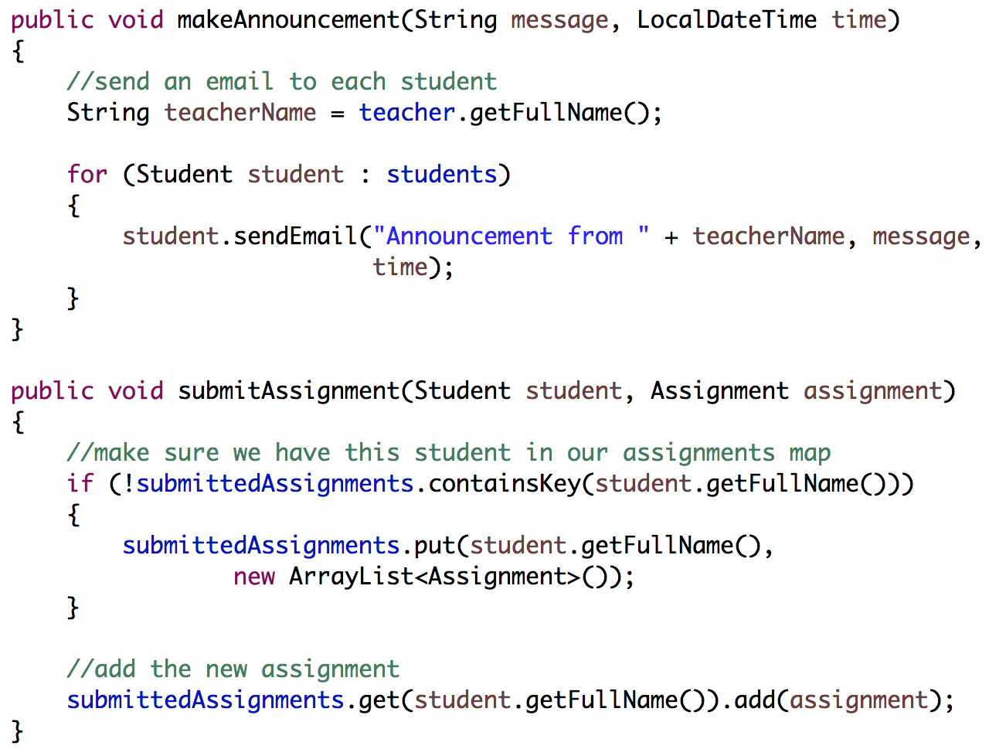
Canvas

Slide 6
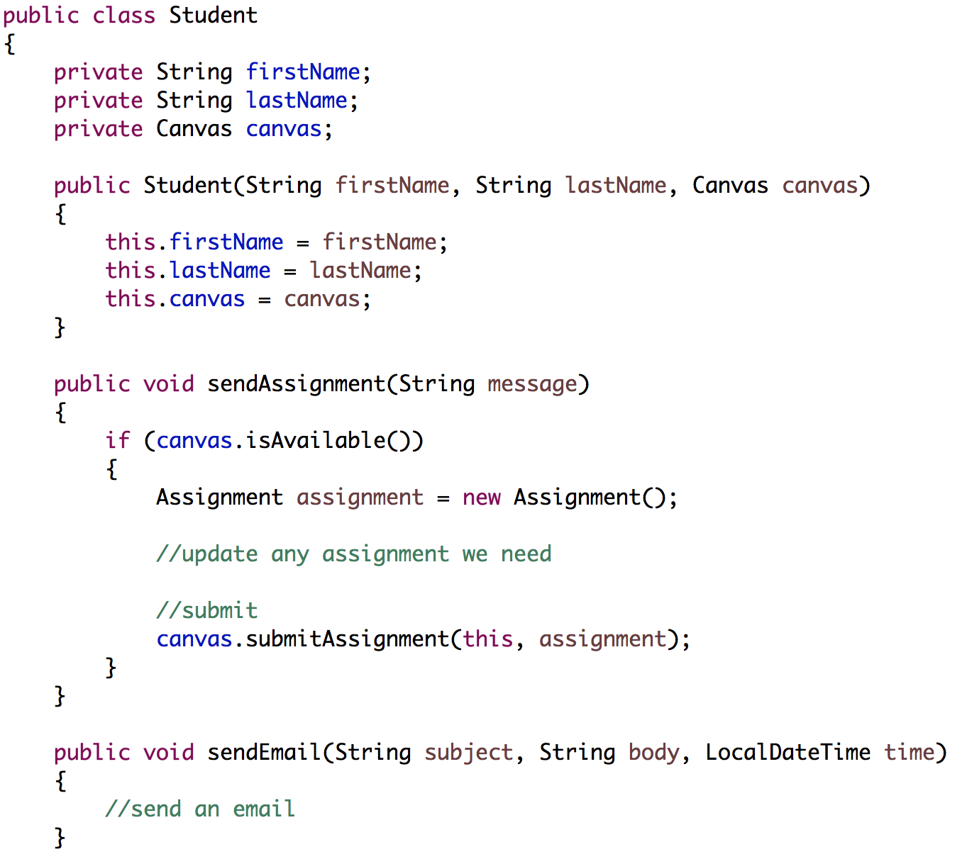
Student
Student depends on on Canvas, Assignment

Slide 7
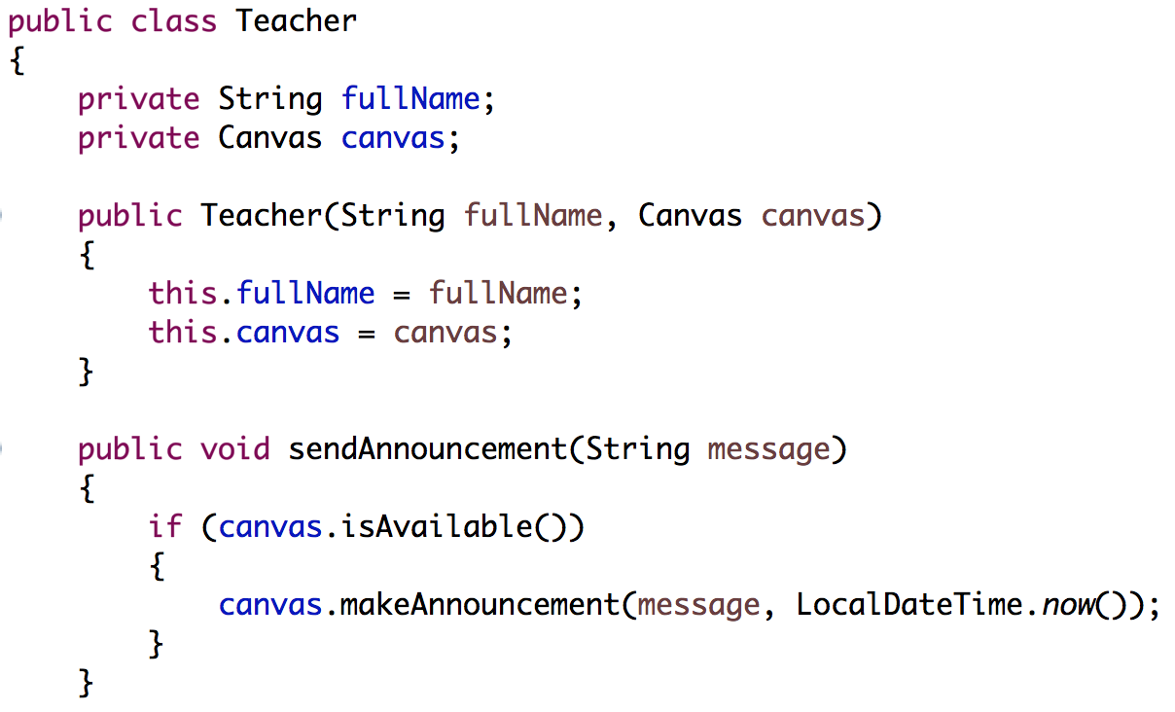
Teacher
Teacher depends on Canvas

Slide 8
Goal: to reduce system coupling
Students
Teachers
Attendance
Assignment
Classroom
Management
Software
(Canvas)

Slide 9
The observer pattern in Java
Goal: to independently react to updates in a class (observable) from another class (observer)
1. See the change…
Change!
Observable
Observer
2. React…

Slide 10

Observable objects
Observable objects store an internal list of observers
Observers are interested in responding to changes in the observable
Observable
List of observers
addObserver()

Slide 11
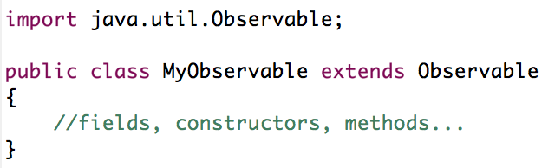
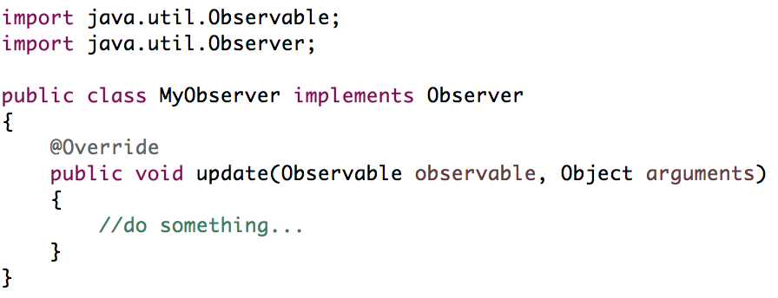
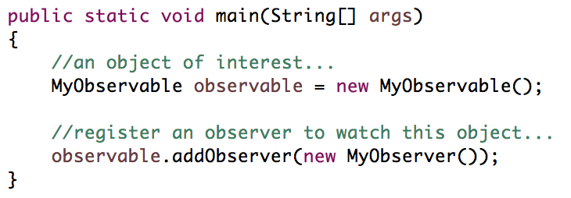
Observables in Java
An observable object inherits from the Observable class.
Observer objects use the Observer interface.
Call addObserver() to register an observer.

Slide 12
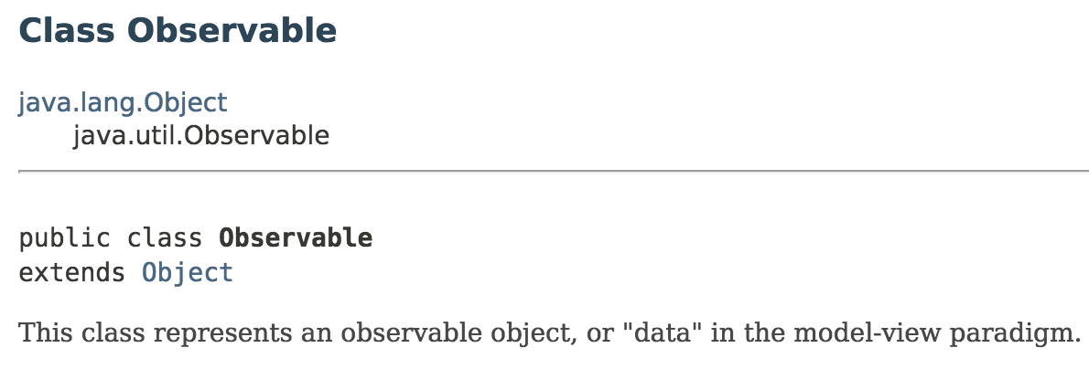
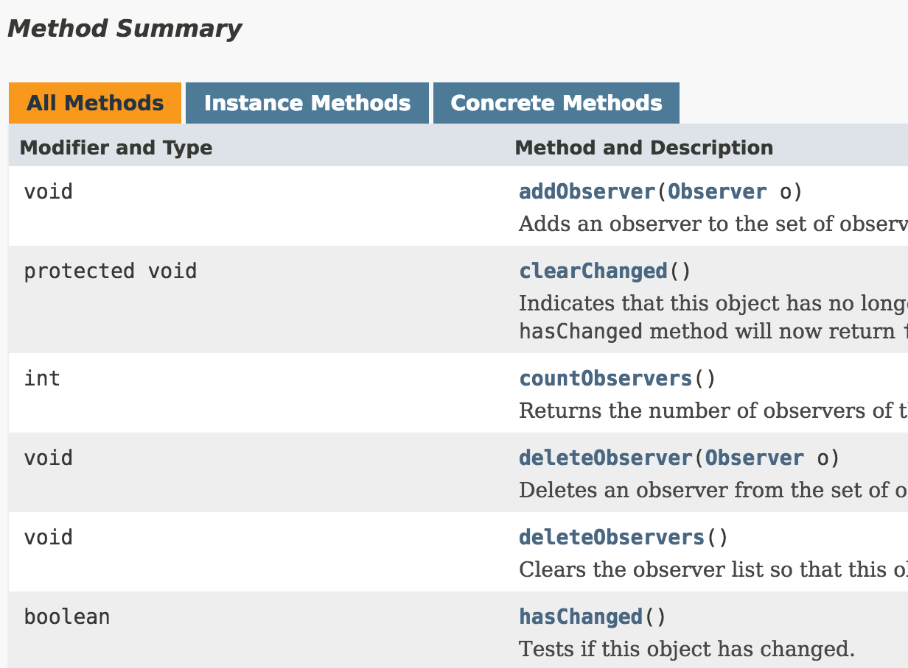

Observable API

Slide 13
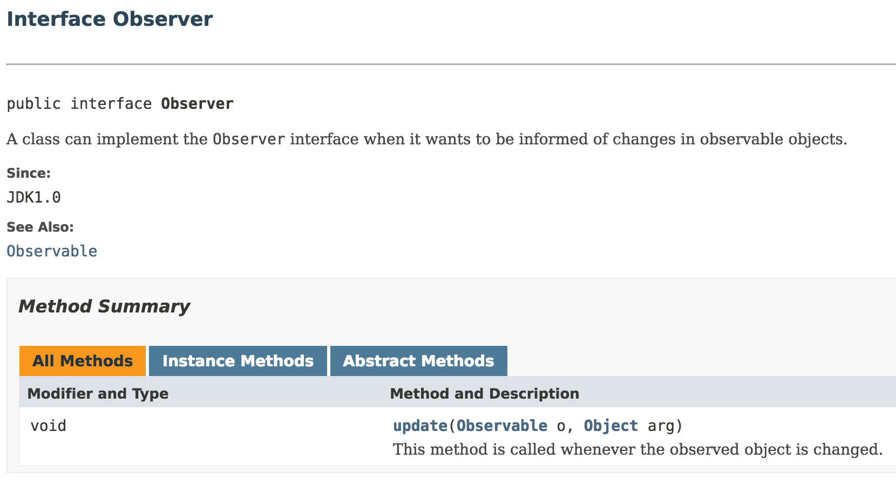
Observer API

Slide 14
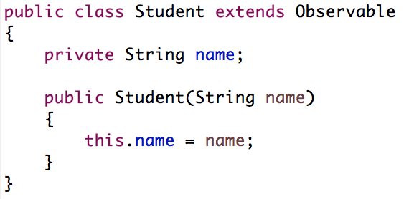
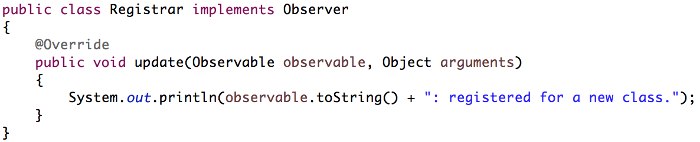
Concrete example
Observable
Observer

Slide 15
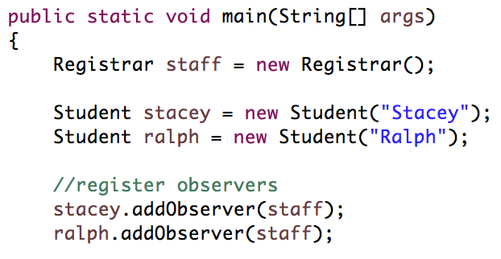
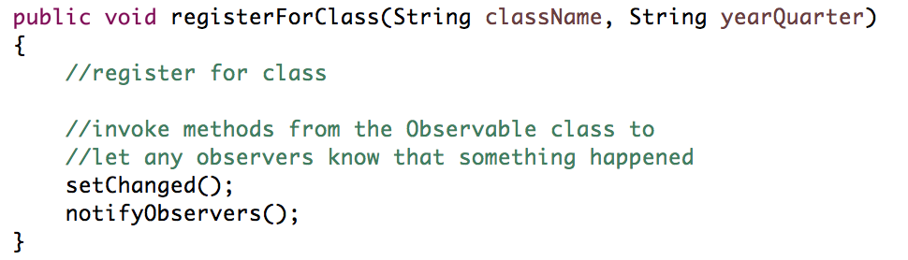
Concrete example
Register observer objects
Flag changes!

Slide 16
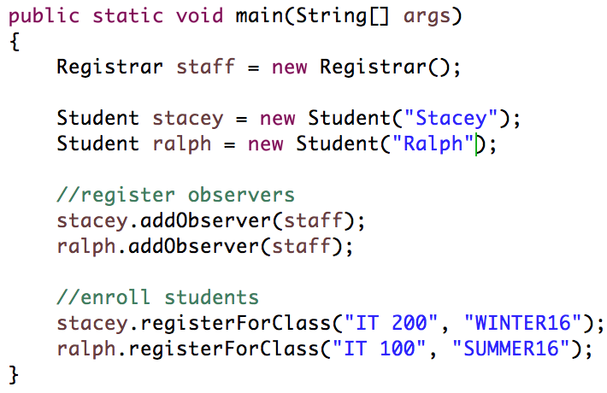
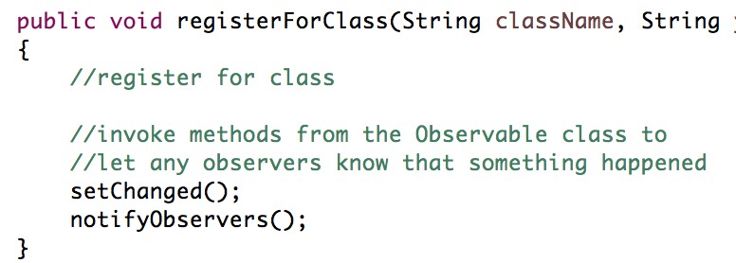

Message flow

Slide 17
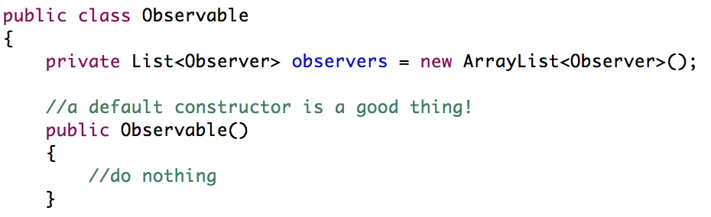
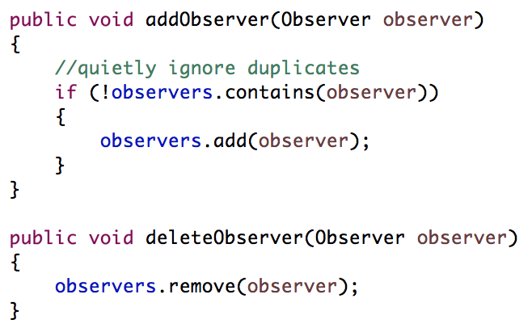
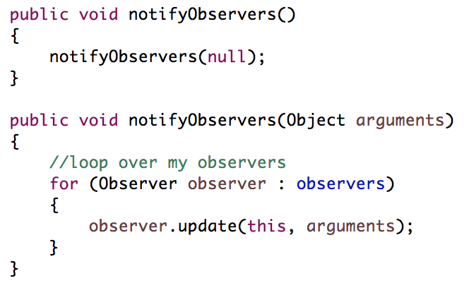
Implementing Observer/Observable

Slide 18
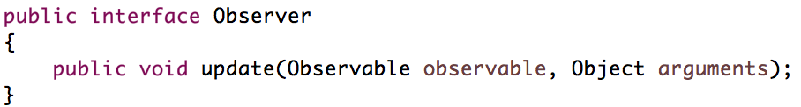
Implementing Observer/Observable

Slide 19


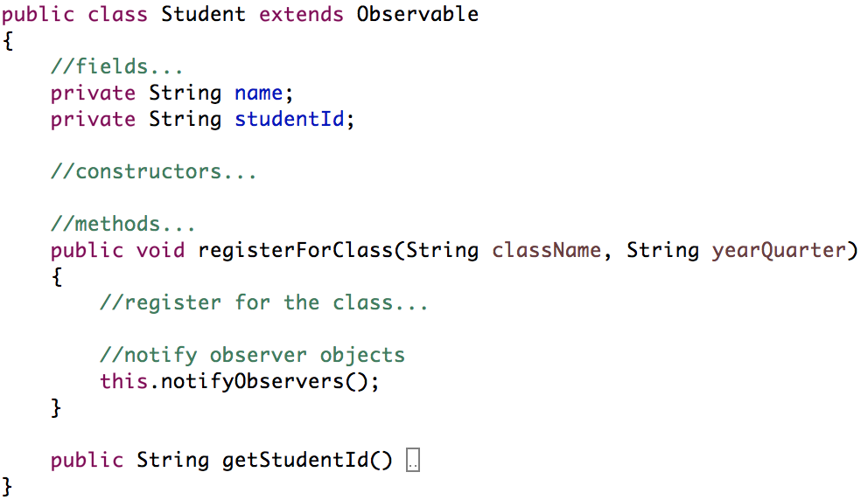
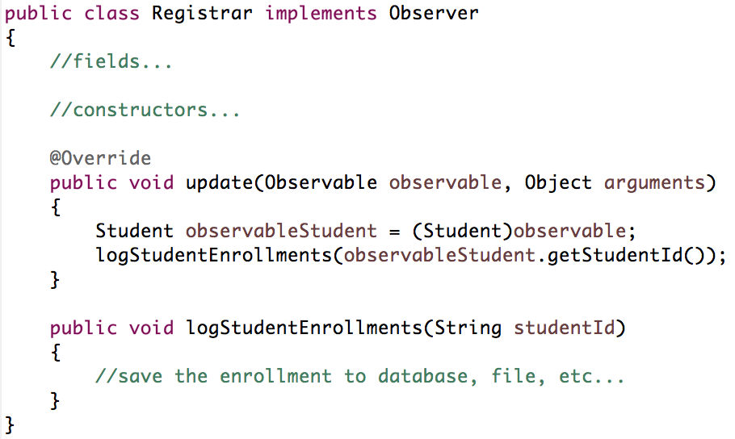
Using our Observable/Observer

Slide 20
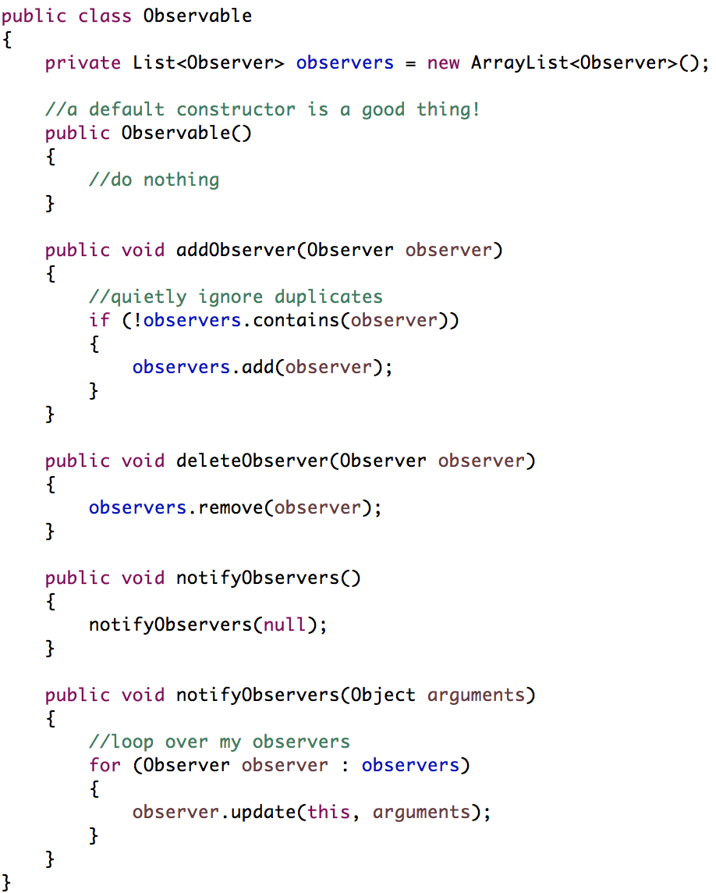
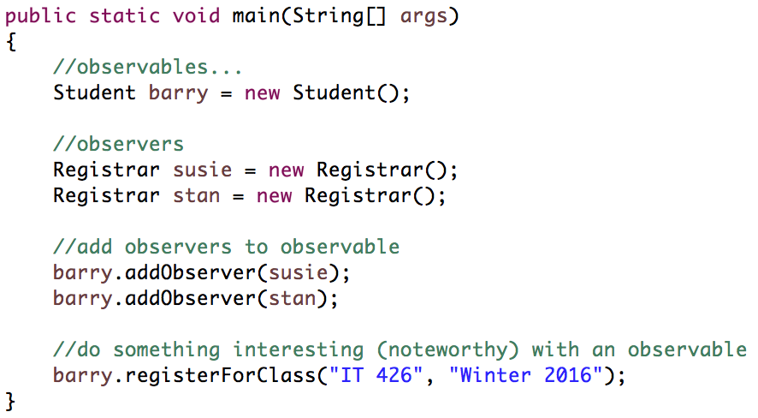
Using our Observable/Observer
Inherited by Student

Slide 21
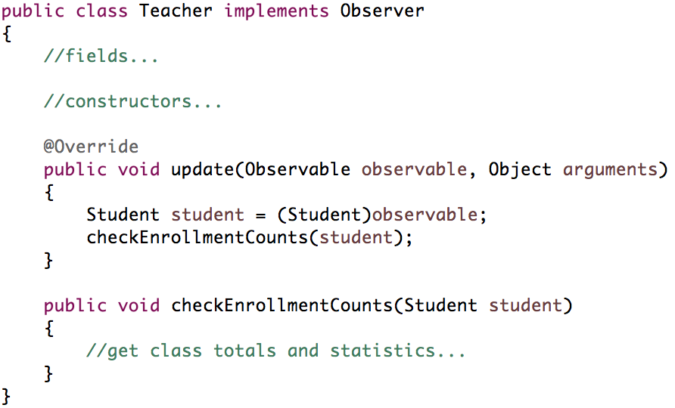
Using our Observable/Observer
Other Observers

Slide 22
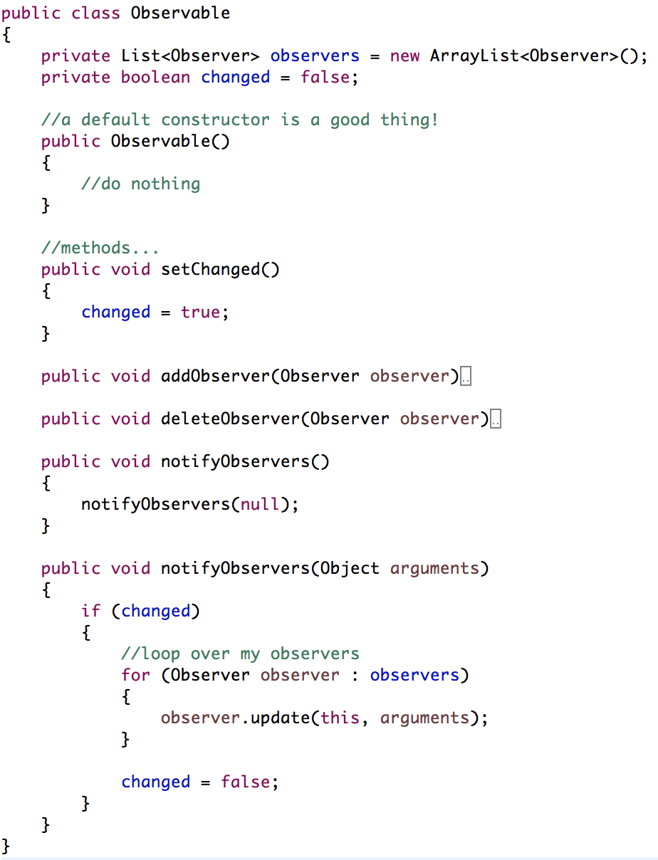
Adding
setChanged()

Slide 23
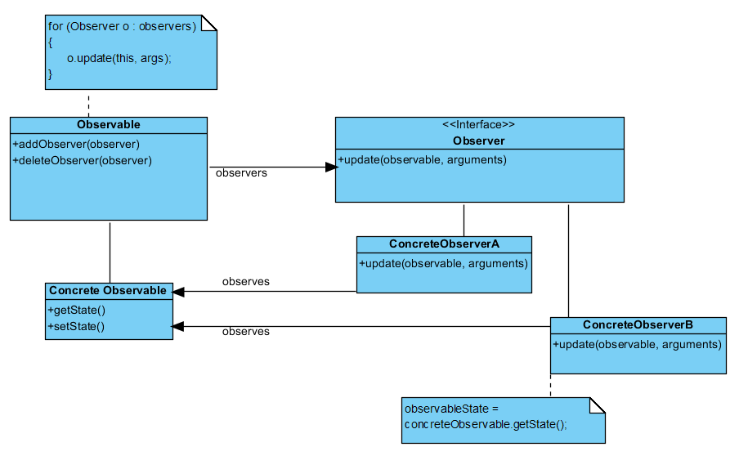
Let’s write some code

Slide 24
Sources
Gamma, Erich, et al. Design Patterns: Elements of Reusable Object-Oriented Software. Indianapolis, IN: Addison-Wesley, 1994

Slide 25
Design Patterns
The Observer Pattern
IT 426

